Slide 1
TK-1st Grade Coronavirus & COVID-19:
What you need to know
Notes:
3-minute radio clip

Slide 2
Today, you will learn about:
Coronavirus and COVID-19
How the coronavirus spreads
Ways to keep yourself, your family, and your community healthy

Slide 3
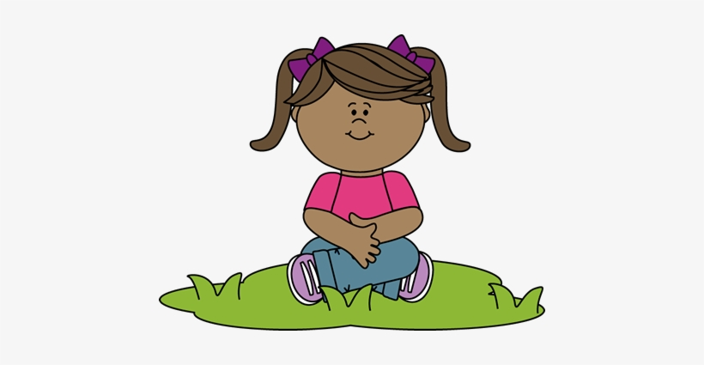
Let’s take a deep breath together.
In...1-2-3-4
Out...1-2-3-4
Let’s repeat 2 more times....
Let’s get ready to learn.

Slide 4
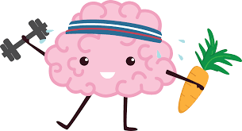
Exercise, sleep, and healthy food help us feel good and not get sick. Let’s learn other ways to stay healthy.

Slide 5
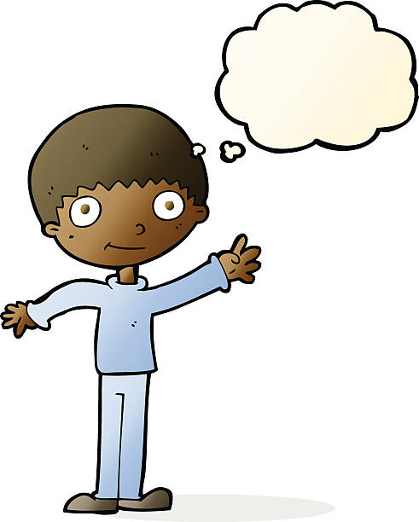
What do you know about the germ called
coronavirus?
What’s a germ?
A germ is a tiny thing that can make us sick.

Slide 6
This germ is called coronavirus.
It got its name because it looks like a crown.
The word corona means crown in Latin.

Slide 7
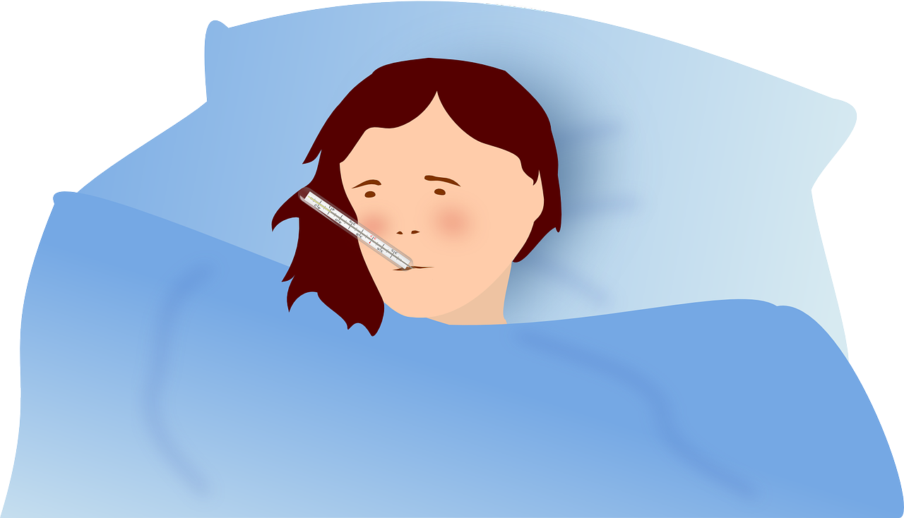
The coronavirus germ can make your body sick with something called COVID-19. It is like when you get sick with the cold or flu.

Slide 8
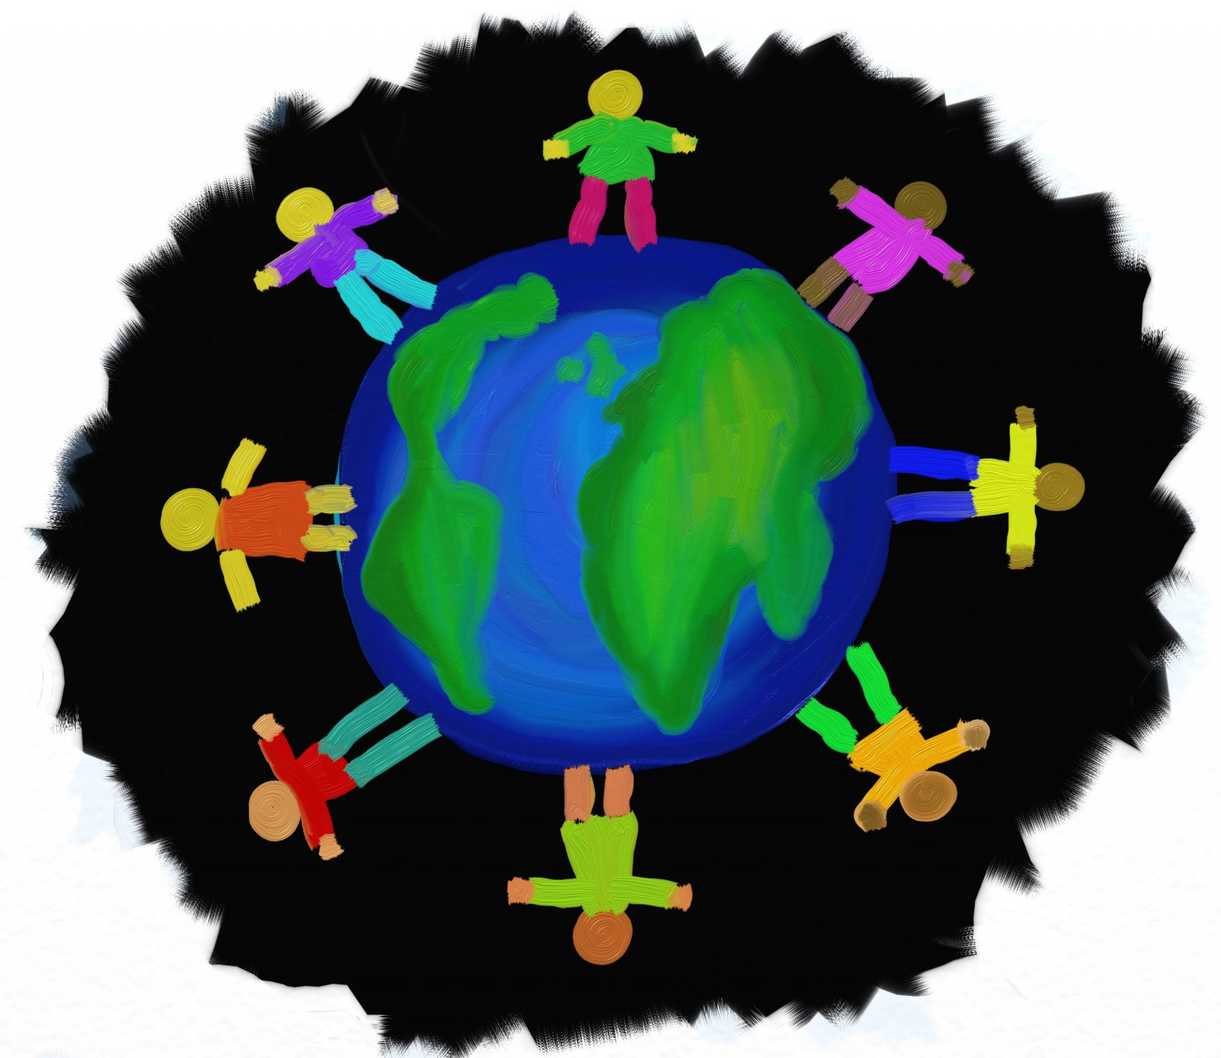
With COVID-19, some people get a little sick, some people get very sick.
Here in San Francisco, only a few people are very sick from COVID-19.

Slide 9
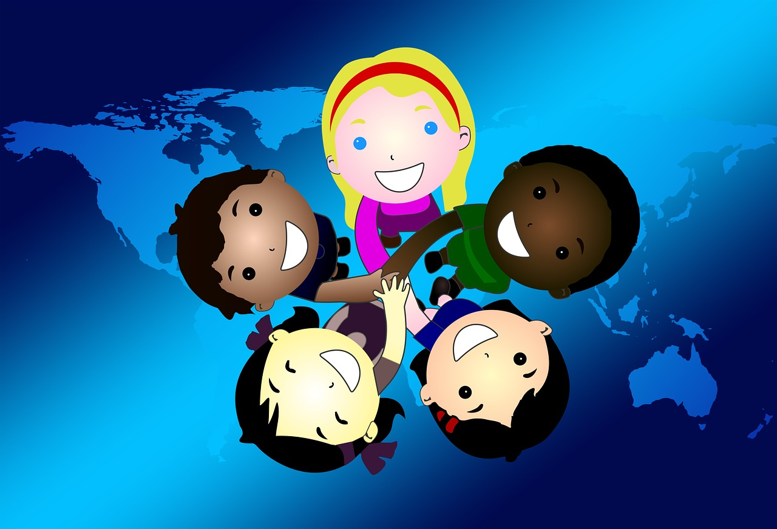
Not a lot of kids are sick with coronavirus.
If kids get the germ, they don’t usually get very sick.

Slide 10
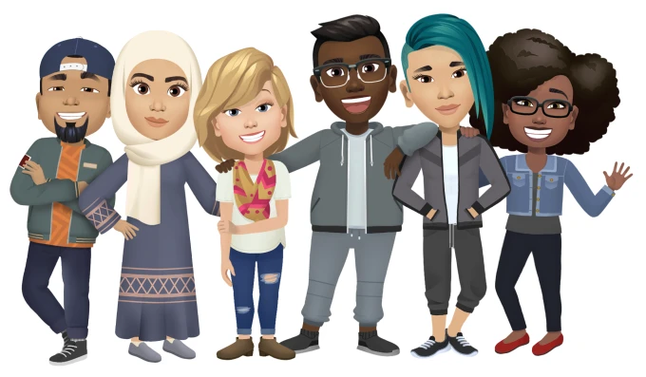
Remember, ANYBODY can get this coronavirus. It doesn't matter where they come from, what language they speak, or what country their parents are from.

Slide 11
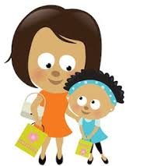
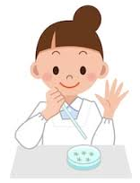
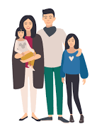
Many people are working to keep you healthy.
Teachers
Helpers of all kinds
Researchers
Nurses & Doctors
Family

Slide 12
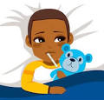
When you are sick, you might have:
A cough
A fever
A hard time breathing
The same happens to people with COVID-19.

Slide 13
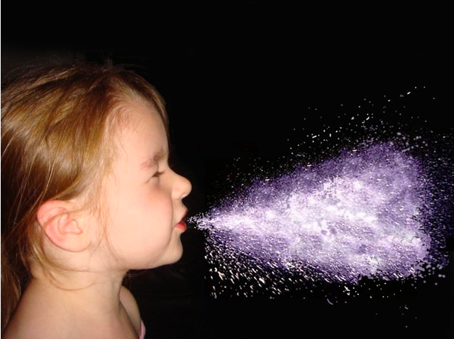
How does the germ get into people?
A person with coronavirus lets out the germ by coughing and sneezing.

Slide 14
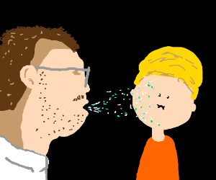
If they cough on you,
the germ can get into your body and you can get sick.

Slide 15
So what should we do?
Sneeze or cough into your elbow.

Slide 16
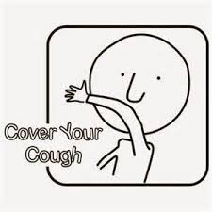
Let’s Practice!
Silently show how you should sneeze or cough into your elbow.

Slide 17
How ELSE can the germ get into people?
A person with coronavirus can let out the germ by coughing or sneezing.

Slide 18
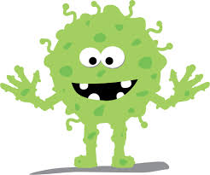
The germ can land on things such as books or pencils.

Slide 19
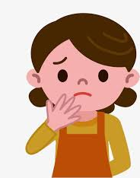
If you touch this book or pencil, then touch your face...
...the germs can go from the book:
to your hands,
then to your eyes, nose, or mouth,
and you can get sick.

Slide 20
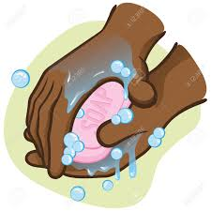
So what should we do?
Wash your hands often with soap and water for 20 seconds.
Sing the Happy Birthday song 2 times while you wash your hands!

Slide 21
When should we wash our hands?
Before & after we eat
After we go to the bathroom
After we sneeze or cough
When we get home
After we play
When else should we wash our hands?
Notes:
Talking Point: And After we touch pets

Slide 22
Let’s Practice!
Let’s sing the Happy Birthday song 2 times together while we pretend to wash our hands.

Slide 23
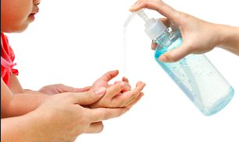
Use hand sanitizer when you cannot wash your hands right away.
Notes:
CDC hand sanitizer fact sheet

Slide 24
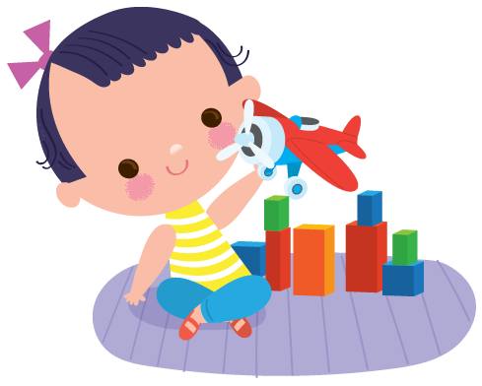
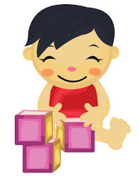
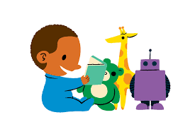
Because people are sick with COVID-19, your days and routines may be different.
You might stay at home more.
You might not see friends as much.
You might not take the bus as much.
You might learn and play at home more than you would at school.

Slide 25
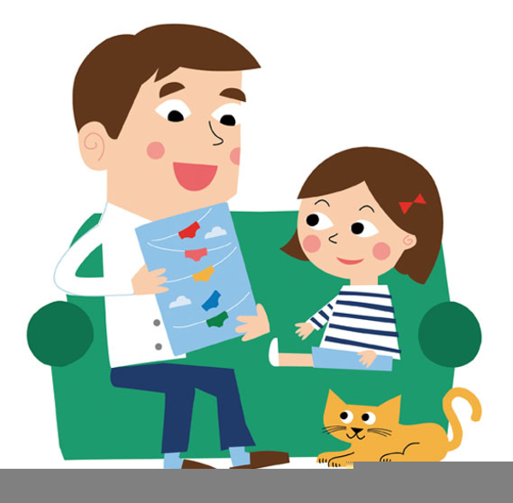
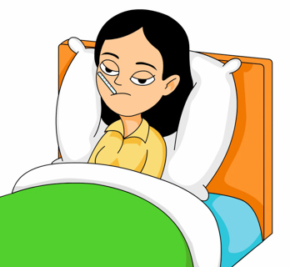
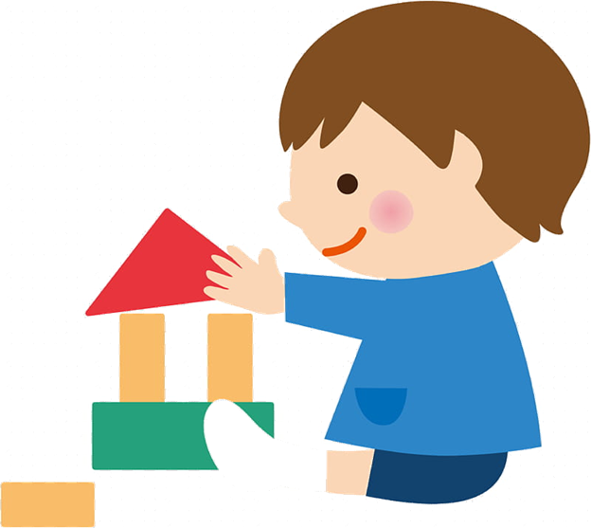
If someone is sick at home, try to stay away!

Slide 26
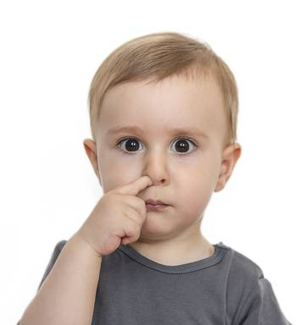
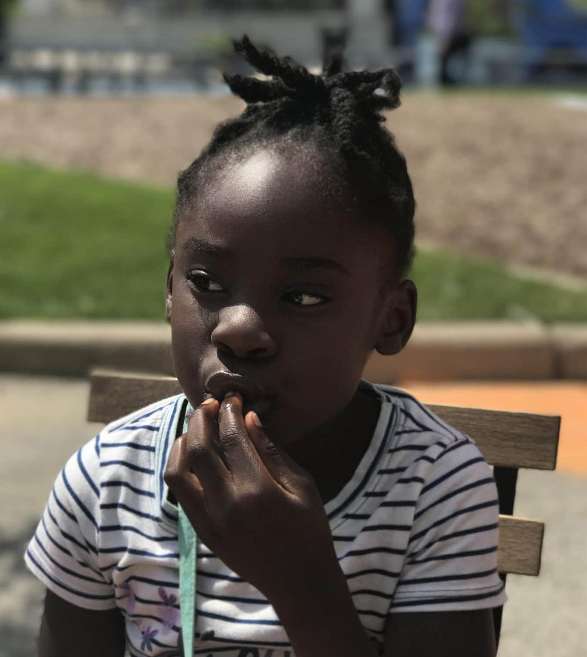
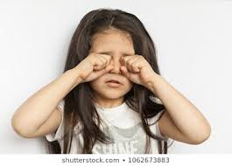
Remember, to keep germs away, DON’T
Don’t pick your nose.
Don’t rub your eyes.
Don’t put fingers in your mouth.

Slide 27
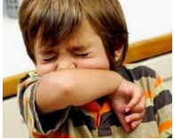
Do:
Wash your hands with soap for 20 seconds.
Sneeze and cough inside your elbow.
Keep hands away from your face.
Keep away from people who are sick.

Slide 28
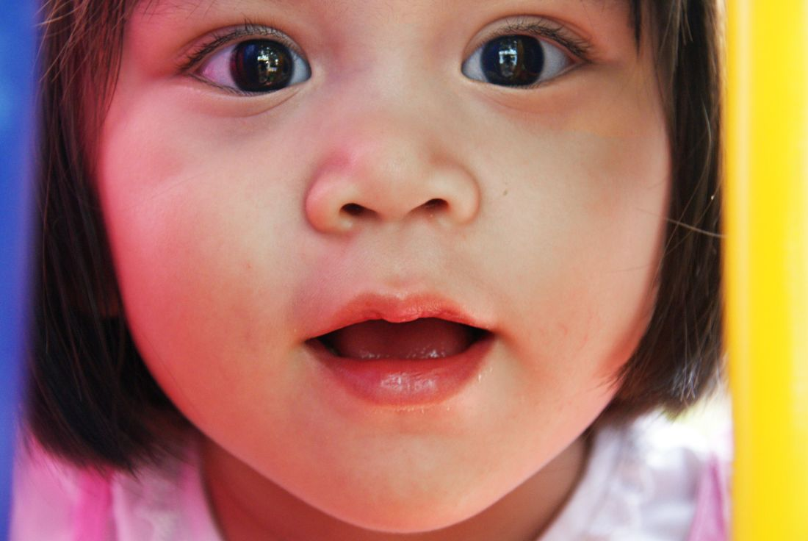
Let’s Review!
What are 3 Don’ts?
Don’t touch your _________
Don’t touch your _________
Don’t touch your _________

Slide 29
Let’s Review!
What are 3 Do’s?
Do wash your hands for ____ seconds
Do sneeze and cough inside your ________.
Keep away from people who are _________

Slide 30
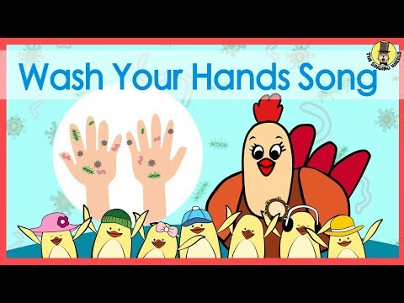
And always remember to WASH YOUR HANDS!

Slide 31
If More Time:
Videos & Extension Activities

Slide 32
Sources
Just For Kids: A Comic Exploring The New Coronavirus (Chinese translation)
Centers for Disease Control

Slide 33
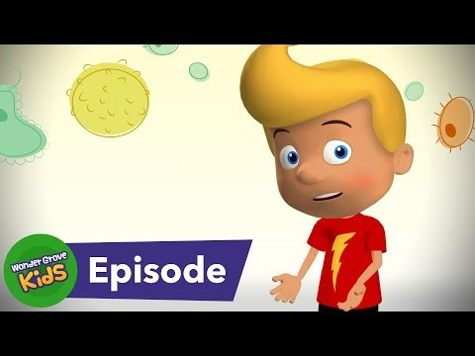
Germs, Germs, Germs

Slide 34
Cough/Sneeze into your elbow

Slide 35
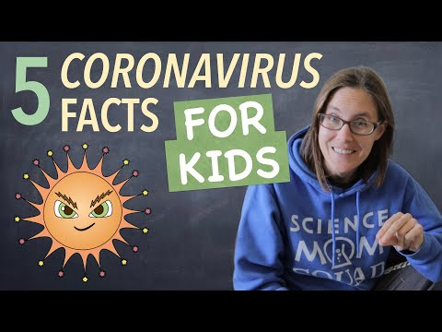

Slide 36
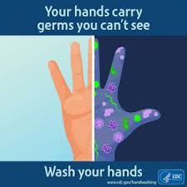
Handwashing Videos
English
Cantonese
Filipino
Mandarin
Spanish
Spanish for kids

Slide 37
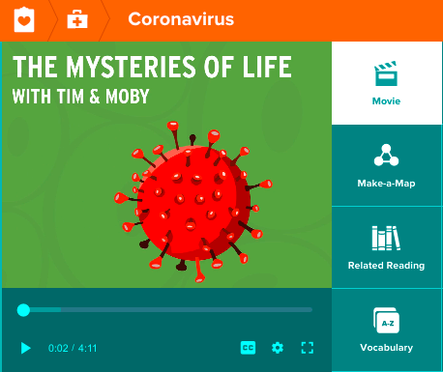
Brainpop Resources
The Mysteries of Life with Tim and Moby

